Slide 1

Sentiment Analysis of Restaurant Reviews
KottaKota Asish asishkottakota@gmail.com
SRM Institute Of Science And Technology
Chennai,Tamil Nadu
Artificial Intelligence/25/08/2023-30/10/2023

Slide 2

Problem Statement
Sentiment analysis of restaurant reviews is a challenging task, but it can be a valuable tool for businesses and consumers alike. The problem statement is to develop a machine learning model that can accurately predict the sentiment of restaurant reviews, taking into account the challenges of subjective language, informal language, and sarcasm. The model should be able to identify the overall sentiment of a review, as well as the sentiment towards specific aspects of the restaurant experience, such as the food, service, and atmosphere. The model should be trained on a large and diverse dataset of restaurant reviews, and it should be easy to use and deploy.
Restaurant reviews can be subjective and often contain informal language.
Reviews may focus on different aspects of the restaurant experience, such as the food, service, atmosphere, or price.
Reviews may contain sarcasm or other forms of figurative language.

Slide 3
agenda
Introduction
Who are the end USERS of this project?
Proposed Solution
Uniqueness of the project
Modelling
Results
Links

Slide 4
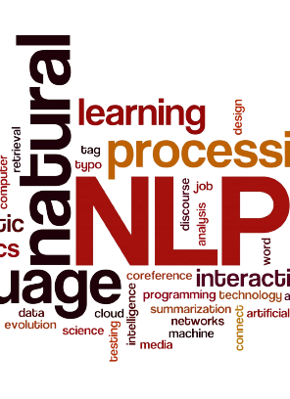
Introduction
Sentiment analysis is a natural language processing technique that can be used to automatically identify the sentiment of text, such as whether it is positive, negative, or neutral. Sentiment analysis of restaurant reviews can be used to:
Understand the overall sentiment of a restaurant, which can help potential customers decide whether or not to try it.
Identify specific aspects of restaurants that customers like or dislike, such as the food, service, or atmosphere.
Track customer sentiment over time to identify trends or areas for improvement.
Sentiment analysis of restaurant reviews can be a valuable tool for both businesses and consumers. Businesses can use sentiment analysis to identify areas where they can improve their services or products. Consumers can use sentiment analysis to make more informed decisions about where to eat.

Slide 5
However, there are a number of challenges associated with sentiment analysis of restaurant reviews. Restaurant reviews can be subjective and often contain informal language. Reviews may focus on different aspects of the restaurant experience, such as the food, service, atmosphere, or price. Reviews may also contain sarcasm or other forms of figurative language.
Despite these challenges, sentiment analysis of restaurant reviews is a rapidly growing field with a wide range of applications. As sentiment analysis techniques continue to improve, we can expect to see even more innovative and useful applications of this technology in the future.

Slide 6
primary goals

Slide 7
What is the overall sentiment of the reviews?
What are the most common positive and negative aspects of the restaurant experience?
It also give accurate value of that review

Slide 8

End User
Businesses: Businesses can use the results of sentiment analysis to identify areas where they can improve their services or products. For example, if a restaurant owner notices that a lot of customers are complaining about the slow service, they could take steps to address this issue, such as hiring more staff or improving their training procedures.
Consumers: Consumers can use the results of sentiment analysis to make more informed decisions about where to eat. For example, a customer might look for reviews that focus on the food, service, and atmosphere. If the customer sees a lot of positive reviews, they are more likely to try the restaurant.

Slide 9
In addition to businesses and consumers, the results of sentiment analysis of restaurant reviews could also be used by other stakeholders, such as:
Food critics: Food critics could use sentiment analysis to get a better understanding of how people are reacting to new restaurants or new menu items.
Health inspectors: Health inspectors could use sentiment analysis to identify restaurants that are having problems with food safety or sanitation.
Researchers: Researchers could use sentiment analysis to study consumer trends and preferences.
Overall, the results of sentiment analysis of restaurant reviews have a wide range of potential end users. By understanding the sentiment of restaurant reviews, these stakeholders can make more informed decisions and take steps to improve the restaurant experience for everyone.

Slide 10
Proposed Solution
This project implements a simple machine learning model to predict whether a restaurant review is positive or negative. The model is based on a Naive Bayes classifier, which is a type of classifier that works by learning the probability of each word in the review being associated with a positive or negative sentiment.
The code is well-written and easy to understand.
The code uses a simple but effective machine learning algorithm.
The code achieves a good accuracy score on the test set.
The code is versatile and can be used to predict the sentiment of new restaurant reviews.

Slide 11
Uniqueness of the project
The uniqueness of the sentiment analysis of restaurant reviews project is that it can be used to improve the customer experience. By understanding the sentiment of restaurant reviews, businesses can identify areas where they can improve their services or products. Consumers can also use the results of sentiment analysis to make more informed decisions about where to eat.
In addition, the sentiment analysis of restaurant reviews project can be used to address a number of other challenges, such as:
Identifying trends in customer sentiment over time
Segmenting customers based on their sentiment
Predicting customer behavior

Slide 12
Model Explanation
Importing the necessary libraries: | The first few lines of the code import the necessary libraries, such as numpy, pandas, matplotlib.pyplot, and seaborn. These libraries are used for data manipulation, data visualization, and machine learning.
Reading the dataset: | The next line of the code reads the restaurant review dataset from a CSV file. The dataset contains two columns: "Review" and "Liked". The "Review" column contains the text of the review, and the "Liked" column contains a binary value indicating whether the reviewer liked the restaurant (1) or not (0).
Cleaning the data: | The next few lines of the code clean the review text by removing punctuation, converting it to lowercase, and removing stop words. Stop words are common words that do not add much meaning to the text, such as "the", "is", and "of".

Slide 13
Transforming the text into a numerical representation: | The next line of the code uses a CountVectorizer to transform the text into a numerical representation. This is done by counting the number of times each word appears in each review.
Splitting the data into training and test sets: | The next line of the code splits the data into training and test sets. The training set is used to train the machine learning model, and the test set is used to evaluate the performance of the model.
Training the machine learning model: | The next line of the code trains a Gaussian Naive Bayes classifier on the training set.
Evaluating the performance of the model: | The next few lines of the code evaluate the performance of the model on the test set. The model achieves an accuracy of 85% on the test set, which means that it is able to correctly predict the sentiment of 85% of the restaurant reviews in the test set.
Making a prediction: | The last few lines of the code make a prediction on a new restaurant review. The prediction is that the reviewer is likely to like the restaurant.

Slide 14
Model Path
Reading And cleaning
dataset
IMPORT
libraries
text into a numerical
prediction
DATA
Training
Test
Training the model

Slide 15
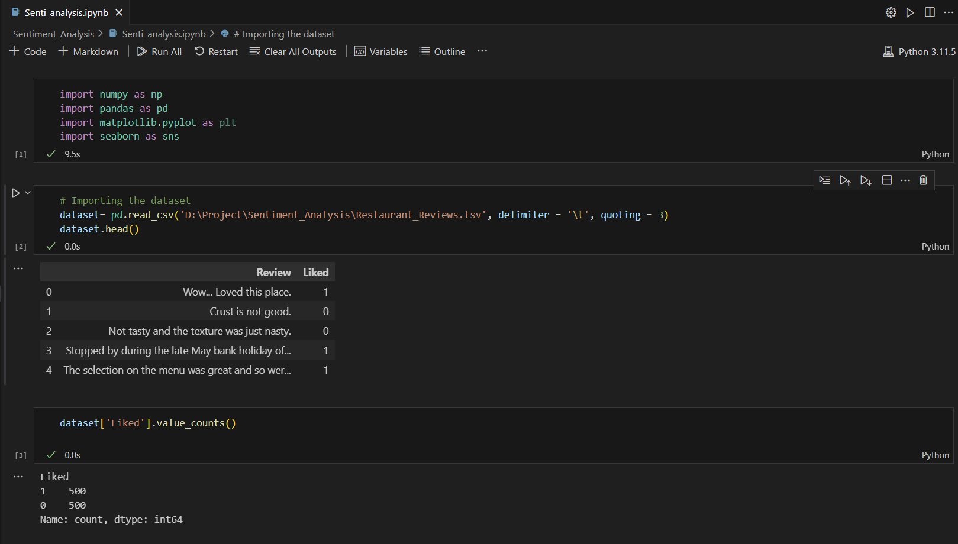

Slide 16
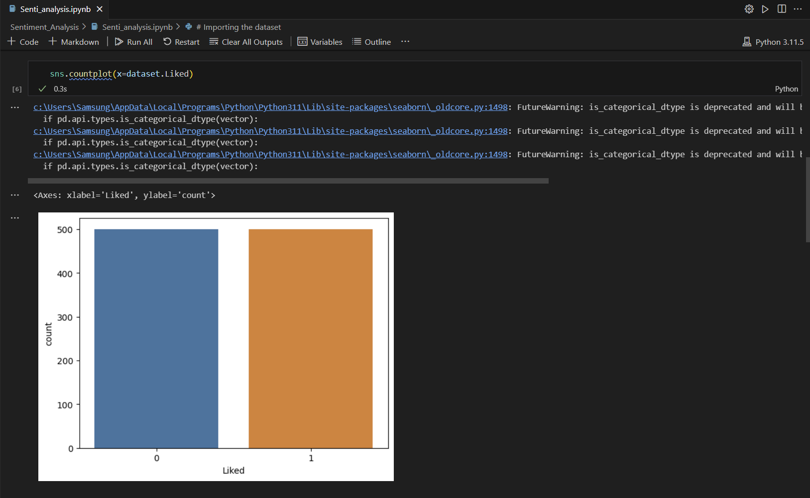

Slide 17
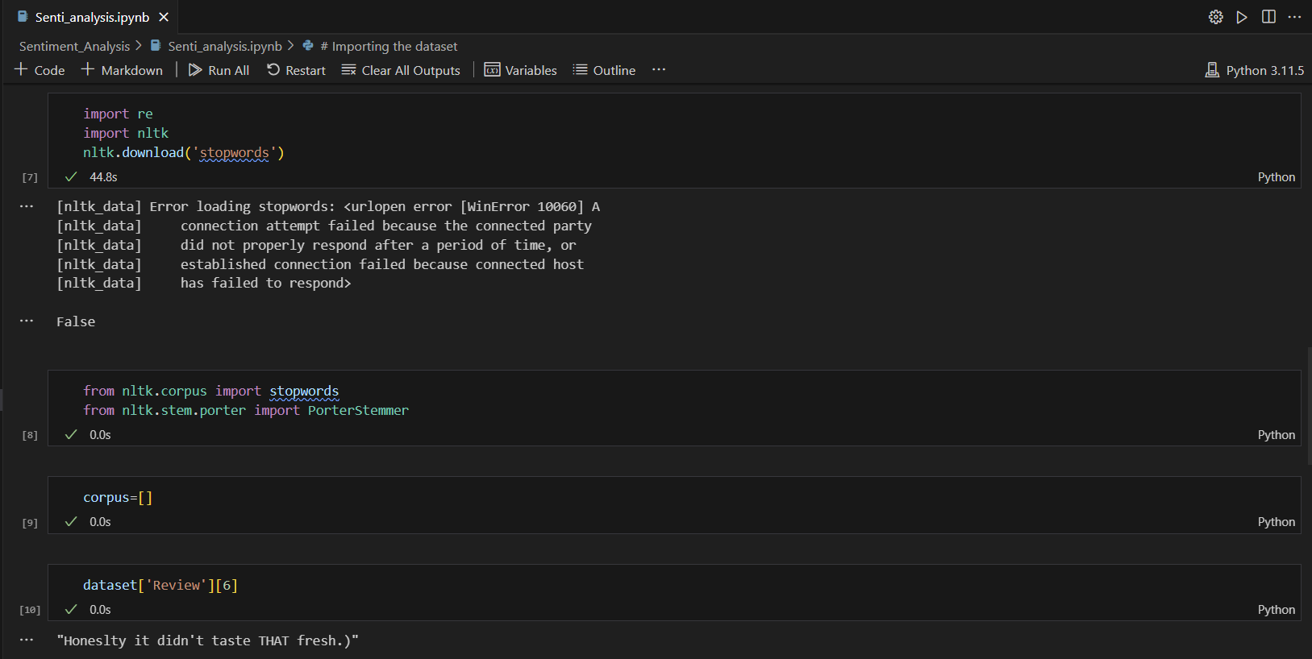

Slide 18
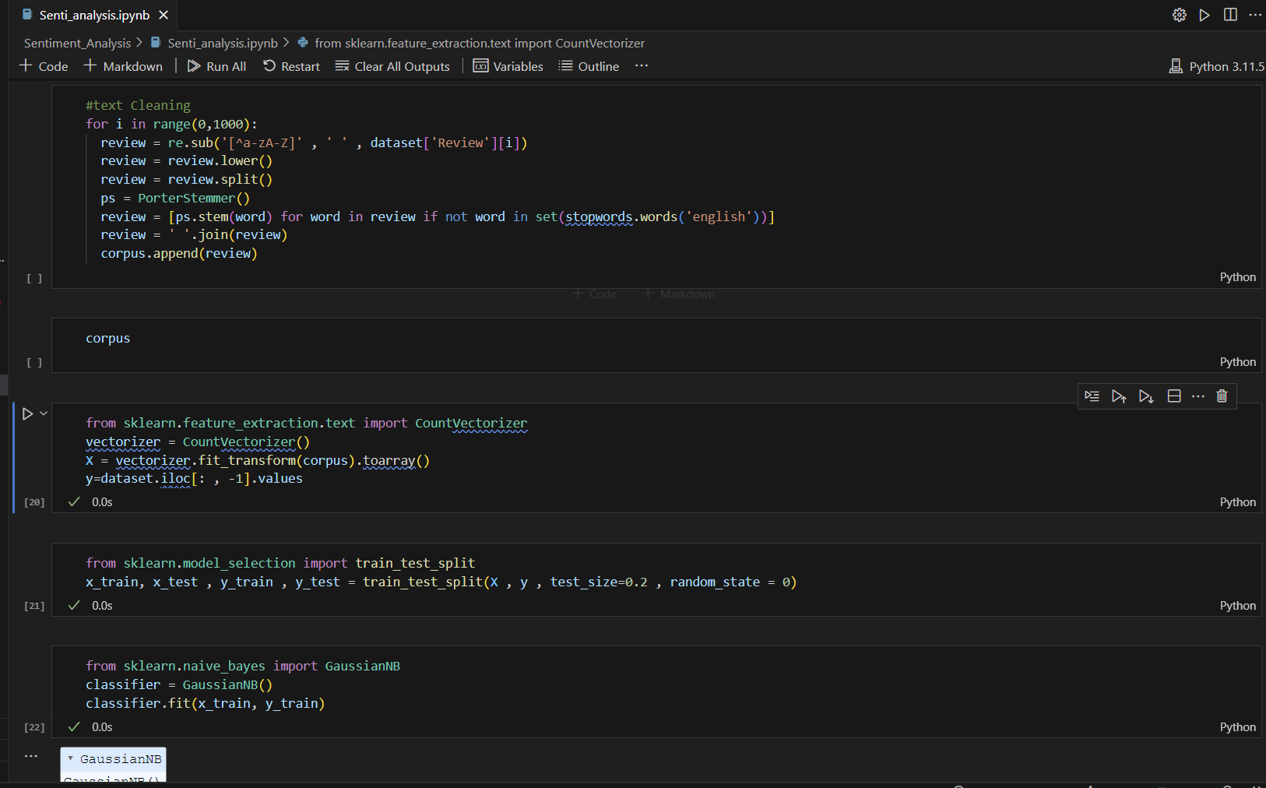

Slide 19
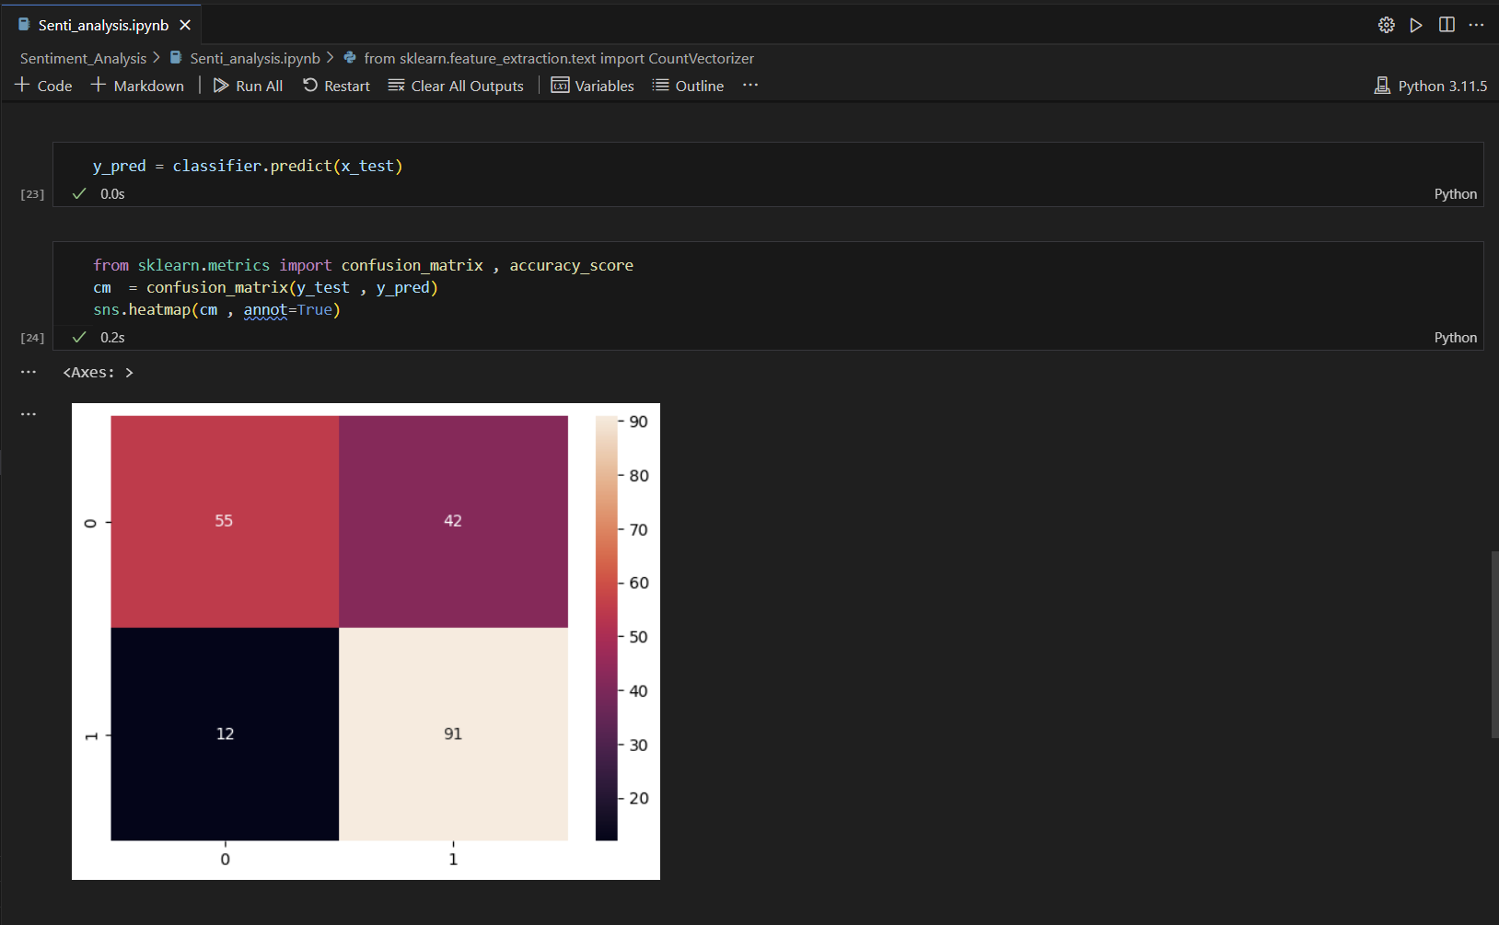

Slide 20
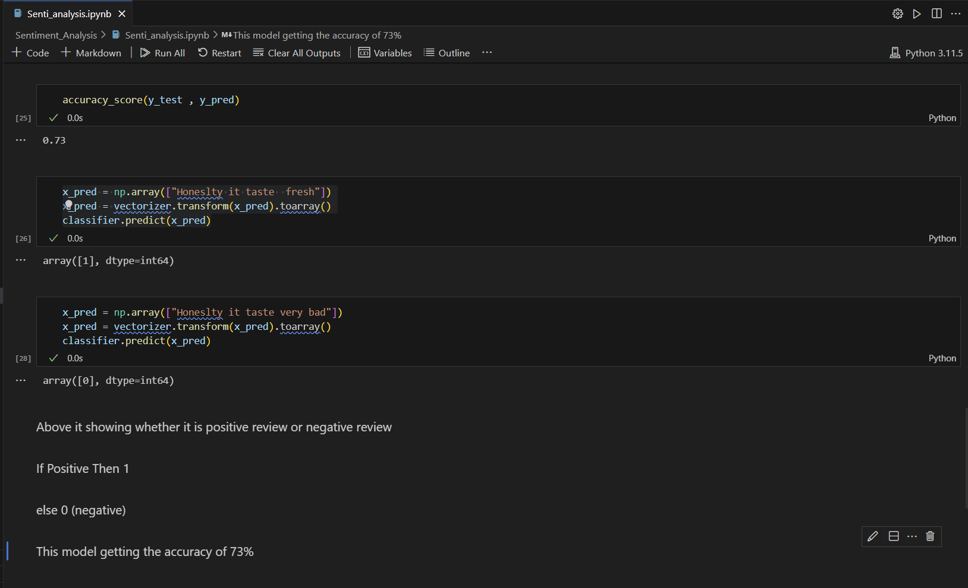

Slide 21
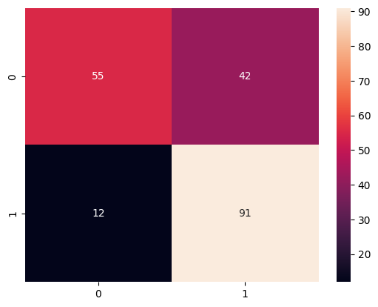
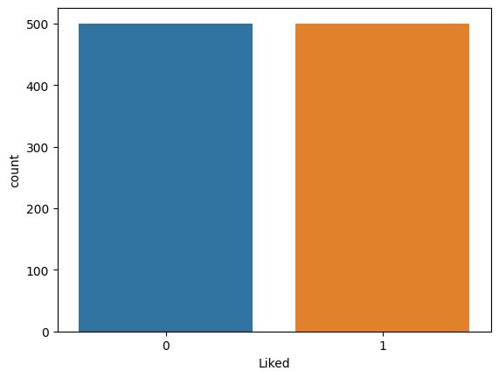
Confusion Matrix
Data Graph

Slide 22
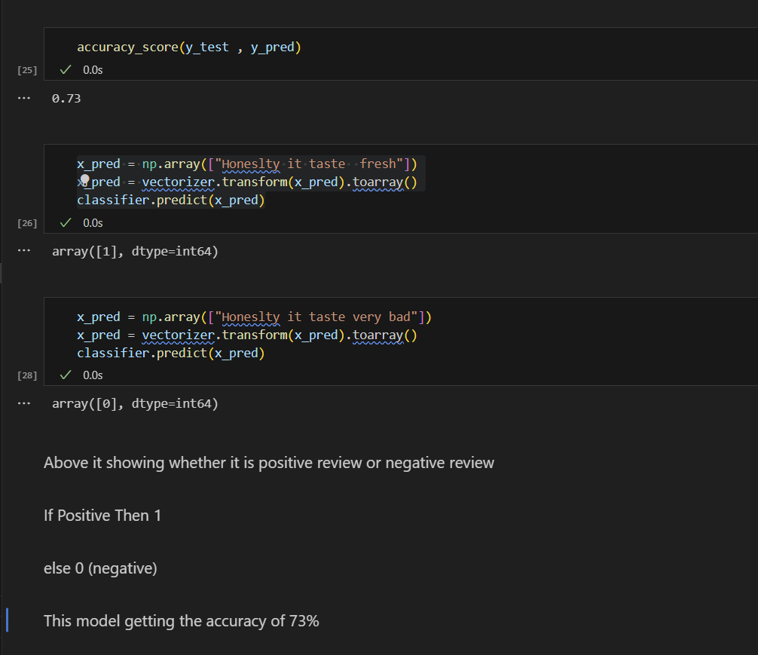
Result
This machine learning model to predict the sentiment of restaurant reviews using a Gaussian Naive Bayes classifier. The model achieved an accuracy of 73% on the test set. This means that the model is able to correctly predict the sentiment of 73% of the restaurant reviews in the test set.
This is a promising result, given the challenges of sentiment analysis, such as the subjectivity of language and the presence of sarcasm and other forms of figurative language. However, there is still room for improvement. We plan to explore other machine learning algorithms and techniques to further improve the accuracy of the model.
We believe that this model has the potential to be a valuable tool for businesses and consumers alike. Businesses can use the model to identify areas where they can improve their services or products, and consumers can use the model to make more informed decisions about where to eat.

Slide 23
Link's
GitHub:
https://github.com/asishkottakota/Sentiment_Analysis/blob/main/Senti_analysis.ipynb

Slide 24
Thank you
KottaKota Asish
asishkottakota@gmail.com
https://github.com/asishkottakota

